Slide 1



Classify Depressive Tweet Using Machine Learning Tools

Slide 2


Introduction
Depression is a mental health disorder that affects millions of people. Globally, an estimated 5% of adults suffer from depression.
Social media platforms such as Twitter provide an outlet for individuals to express their emotions and thoughts publicly.
Using machine learning tools to identify depressive tweets could allow for targeted interventions and support.

Slide 3
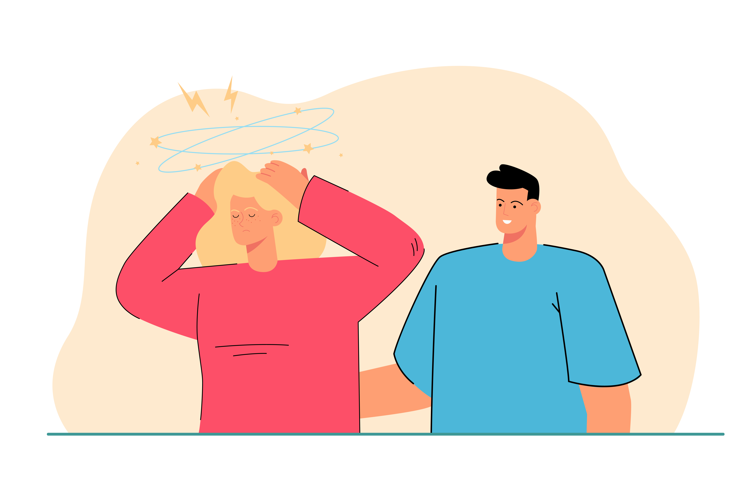
Motivation
Lack of awareness and knowledge of the symptoms can make it challenging to seek professional help.
Machine learning tools could provide a non-invasive and easily accessible way.
Help find depressive symptoms early.
Encourage those social media platform like Facebook, TikTok, Instagram add automatically detection tool.

Slide 4
Related Work
Early works like Nadeem et al.(2016) used statistical classifiers to estimate the risk of depression, achieved about 86% accuracy.
Mowery et al.(2016) developed classifiers to detect depressive symptoms from tweets.
Other methods used like fine-tuned models by Rizwan et al.(2021) and Lin et al.(2020) combined CNN and BERT to use both visual and textual content.
I will explore more on Information processing, deep learning model, and web application build.

Slide 5
Methodology
NLP tools like NLTK to do tweet text process.
TF-IDF to extract tweet features.
Compare traditional classifiers like Logistic Regression, KNN, SVM and Random Forest.
If necessary, LSTM or fine-tuned model like BERT to improve the performance.
Python Flask for backend server, React for frontend UI.

Slide 6
Reference
World Health Organization. "Depression." World Health Organization. https://www.who.int/news-room/fact-sheets/detail/depression.
Nadeem, M., Horn, M., Coppersmith, G., Hopkins University, J., & Sen, S. (2016). Identifying Depression on Twitter.
Mowery, D., Park, A., & Bryan, C. (2016). Towards Automatically Classifying Depressive Symptoms from Twitter Data for Population Health. http://liwc.wpengine.com/
Lin, C., Hu, P., Su, H., Li, S., Mei, J., Zhou, J., & Leung, H. (2020). SenseMood: Depression detection on social media. ICMR 2020 - Proceedings of the 2020 International Conference on Multimedia Retrieval, 407–411. https://doi.org/10.1145/3372278.3391932
Rizwan, M., Mushtaq, M. F., Akram, U., Mehmood, A., Ashraf, I., & Sahelices, B. (2022). Depression Classification From Tweets Using Small Deep Transfer Learning Language Models. IEEE Access, 10, 129176–129189. https://doi.org/10.1109/ACCESS.2022.3223049

Slide 7
Methodology
Collect Normal Tweet (Label 0)
Text Processing
Classification Models
Web Application
Collect Depressive Tweet (Label 1)

Slide 8
Data Collection
Normal Tweet come from the Sentiment140 dataset https://www.kaggle.com/datasets/kazanova/sentiment140, randomly pick 60,000 tweet.
Depressive Tweet come from https://github.com/miladrezazadeh/twitter_depression_detection/blob/main/data/processed/processed_data.csv, which is a separate dataset of tweets that had been scraped by public Twitter API using keywords related to depression.
Merge and Shuffle two dataset, Normal Tweet with label 0, Depressive Tweet with label 1.

Slide 9
Text Processing
Input Text : Hey @username, check out this amazing #AI model! It's capable of understanding and generating text, isn't that awesome? Find more info at: https://www.example-ai.com/ 🚀
Output Text : hey check amazing ai model capable understanding generating text awesome find info
TF-IDF vectorizer : 67317x10000 sparse matrix

Slide 10
Classification Models
Traditional Classifiers : Logistic Regression, Support Vector Machine, K-Nearest Neighbors Algorithm, Random Forests. Except KNN, all achieved good performace (More than 95%).
Deep Learning Model : Long Short Memory
Pre Trained Model : BERT, BERT could classify 2000 tweet in 100% correct.

Slide 11
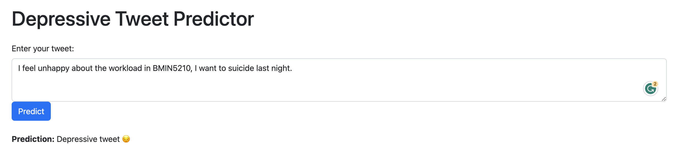
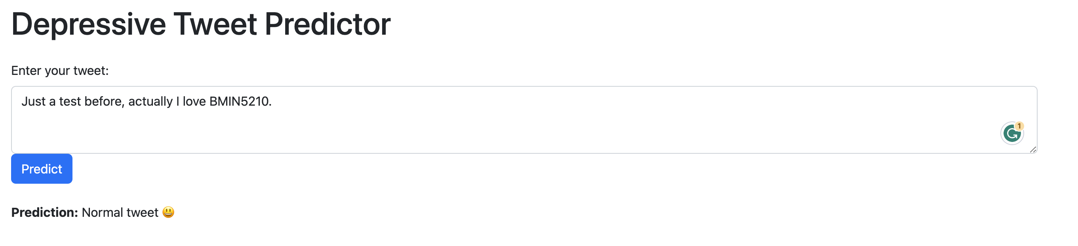
Web Application

